Slide 1
Software Engineering and Design Task 3
Designing a Mobile Application

Slide 2
Scoping
The target users are psychotherapists (doctors or psychologists) in mental health hospitals or local practices.
The application can be used on tablets and notebooks (a smartphones-app is not convenient for psychotherapists needs).

Slide 3
Scoping
Focus on treatment related functionality and not general medical administration.
Short time horizon: Constrains the feature scope of the application to a few key features.
The success can be measured by a closely interaction with the target users (demo and validation for each functionality of the software).

Slide 4
Research
Interview with a doctor (inner medicine) from the "Inselspital".
Short demo of the "Krankenhausinformationssystem" (KIS) (CGM Phoenix) from the "Inselspital".

Slide 5
Research
What is the most important information about a patient from the doctors perspective?
Personal data (name, age, gender, ...)
Diagnosis
Drugs
Treatment process

Slide 6
Research
Differences of psychiatrist and clinical psychologist?
both are psychotherapists
A psychiatrist is a doctor, who is specialized in psychiatry and can prescribe drugs.
A clinical psychologist is a psychologist, who has a special education in psychotherapy, but can't prescribe drugs (in general).

Slide 7
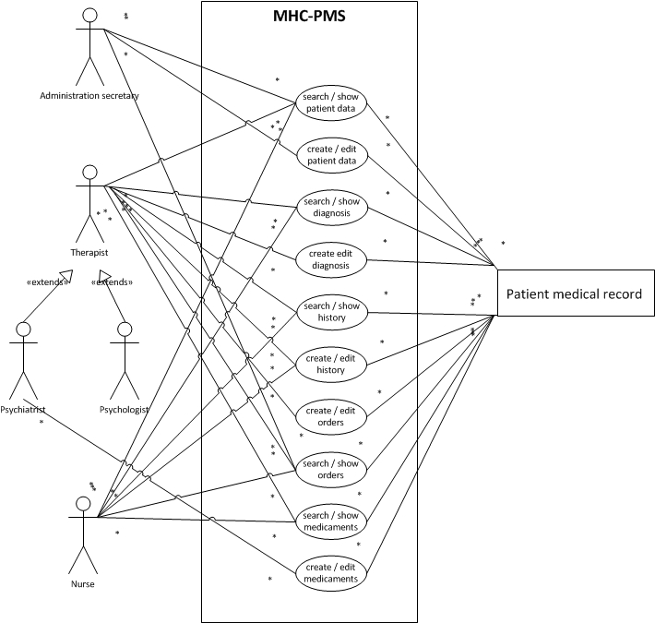
Synthesize

Slide 8
Design
Storyboard:
Therapist and patient meet
Therapist informs himself about the patients history
The patient tells the therapist about his condition
The therapist informs himself by using the ICD10 (references) (optionally)
Therapist creates a diagnosis
Therapist prescribes medicine (optionally) (only psychiatrist, not psychologist)
Therapist passes an order (optionally)
The patient leaves

Slide 9
Prototype
The prototype is signed on several sketchboards (see separate pictures)

Slide 10
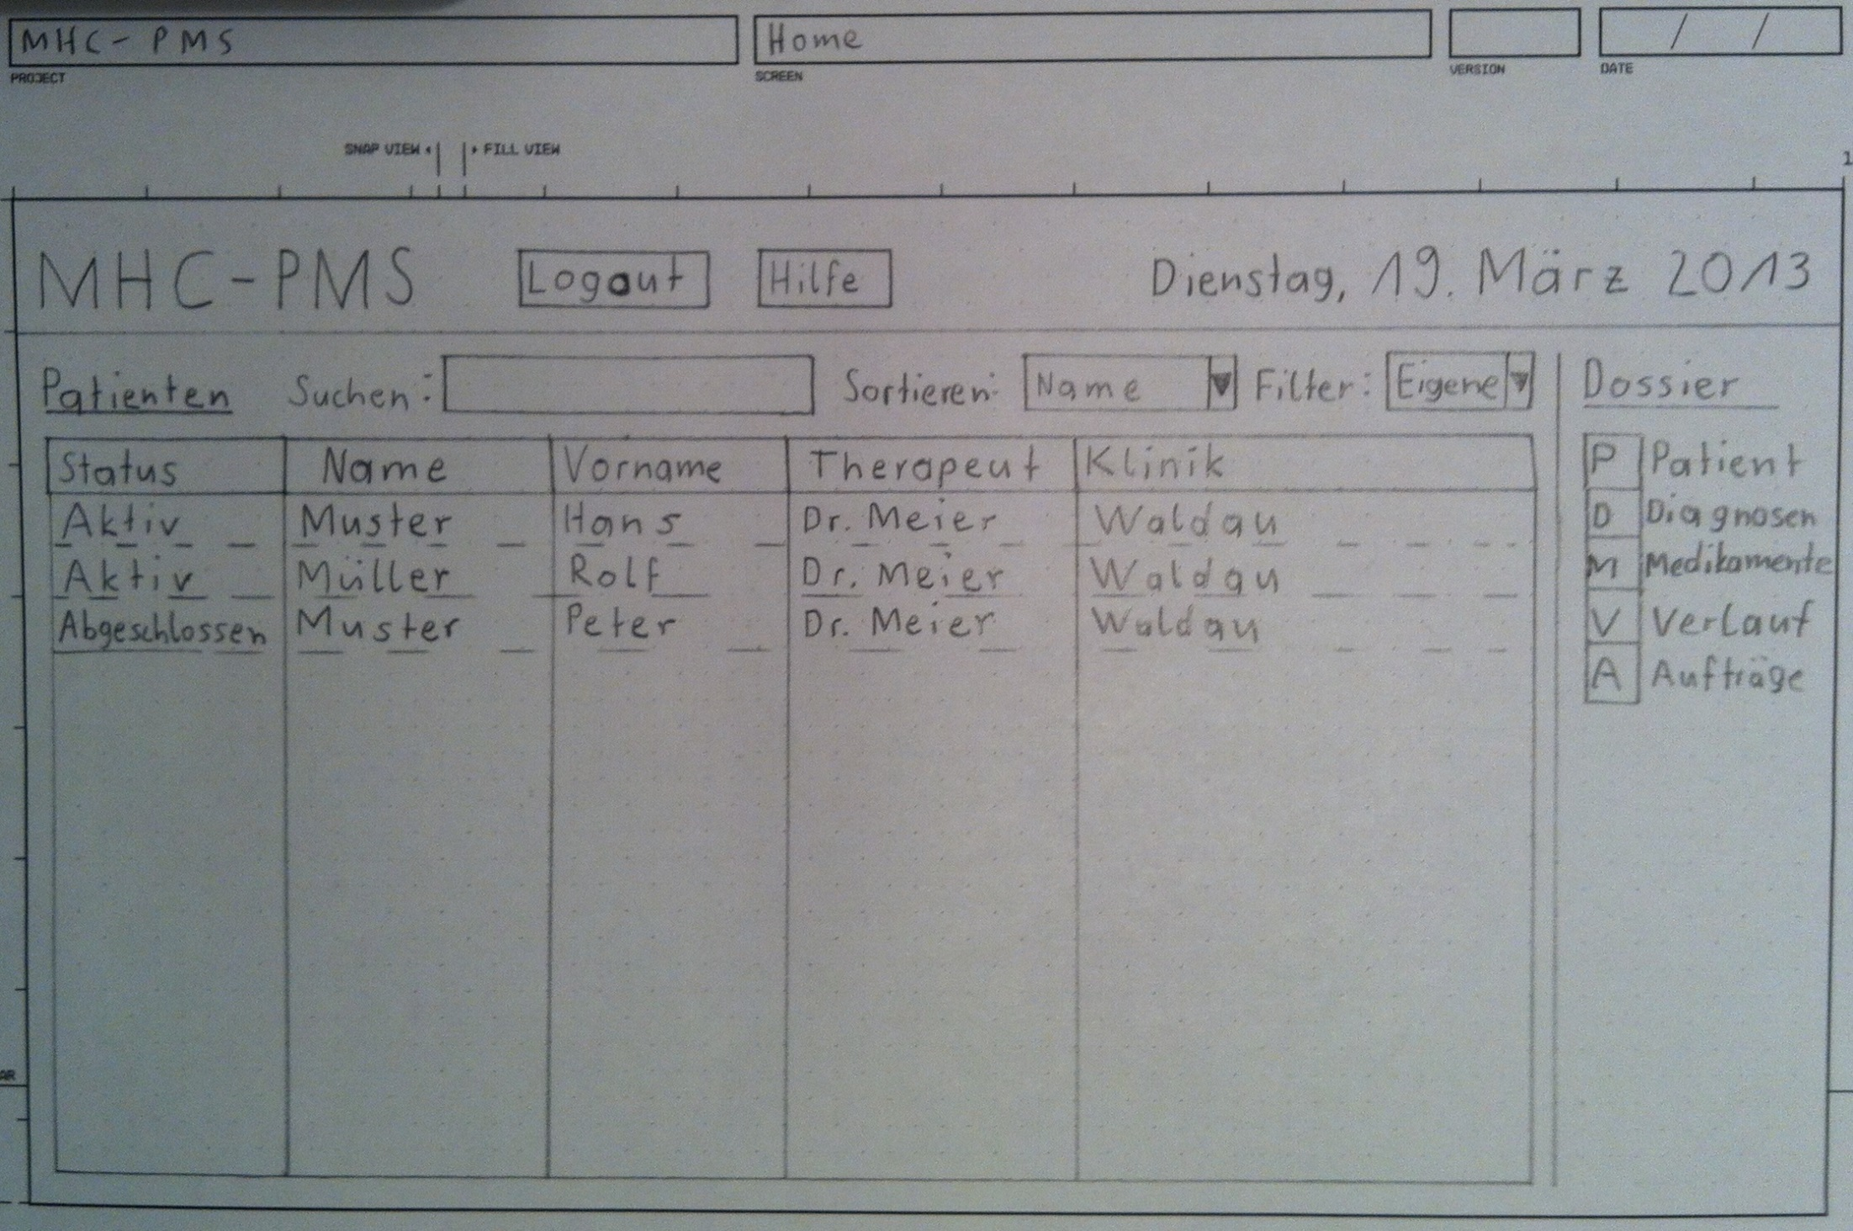

Slide 11
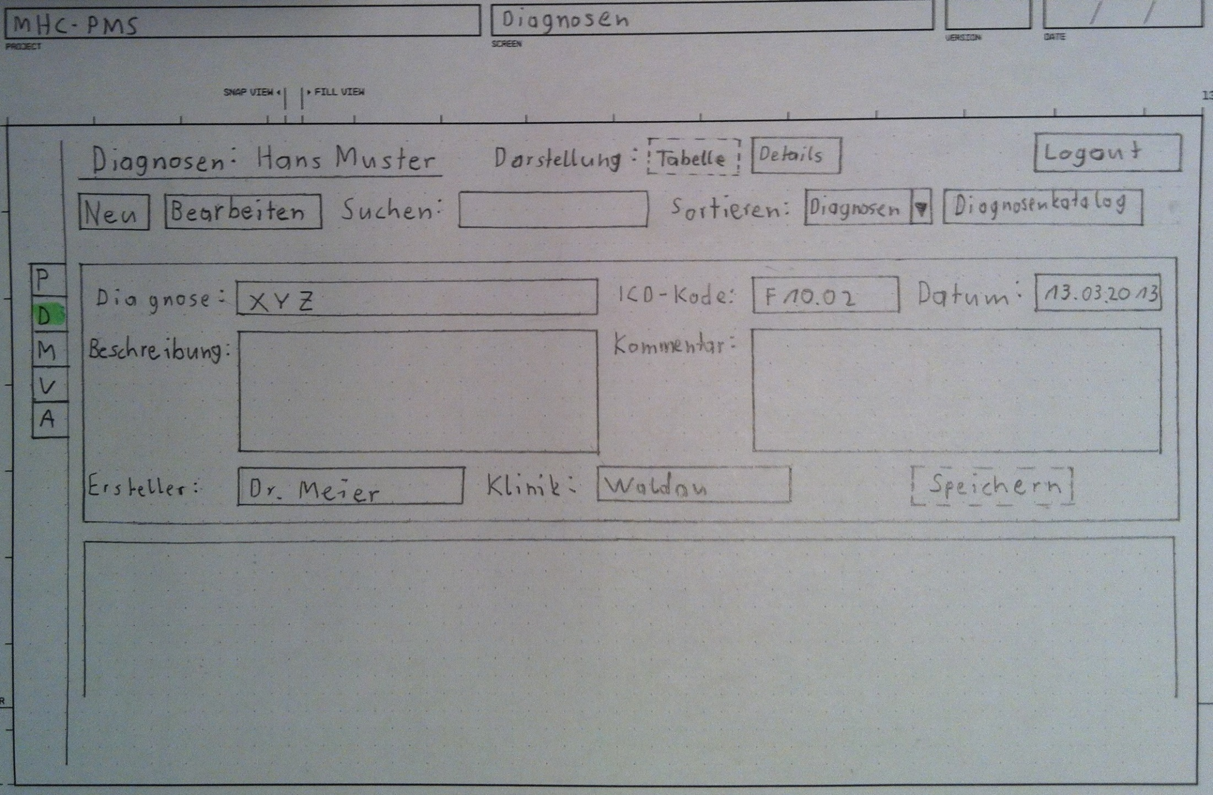

Slide 12
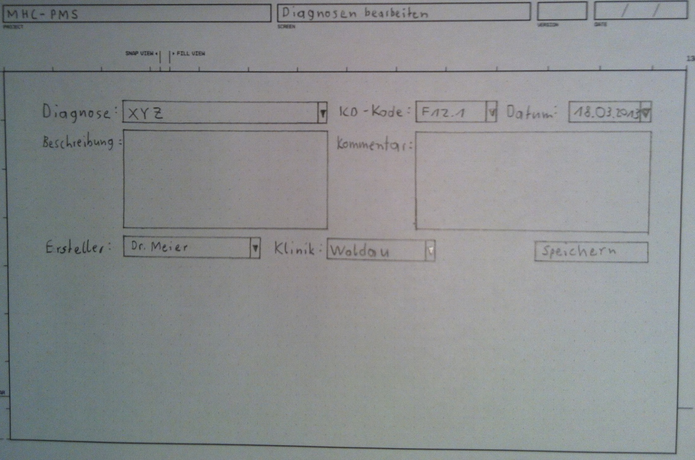

Slide 13
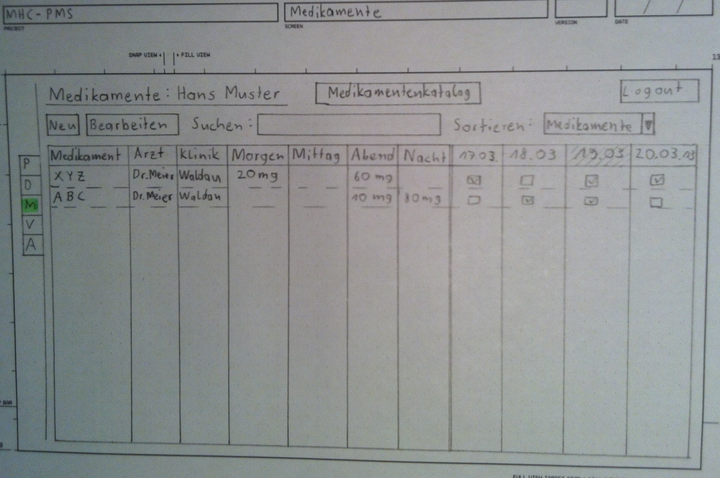

Slide 14
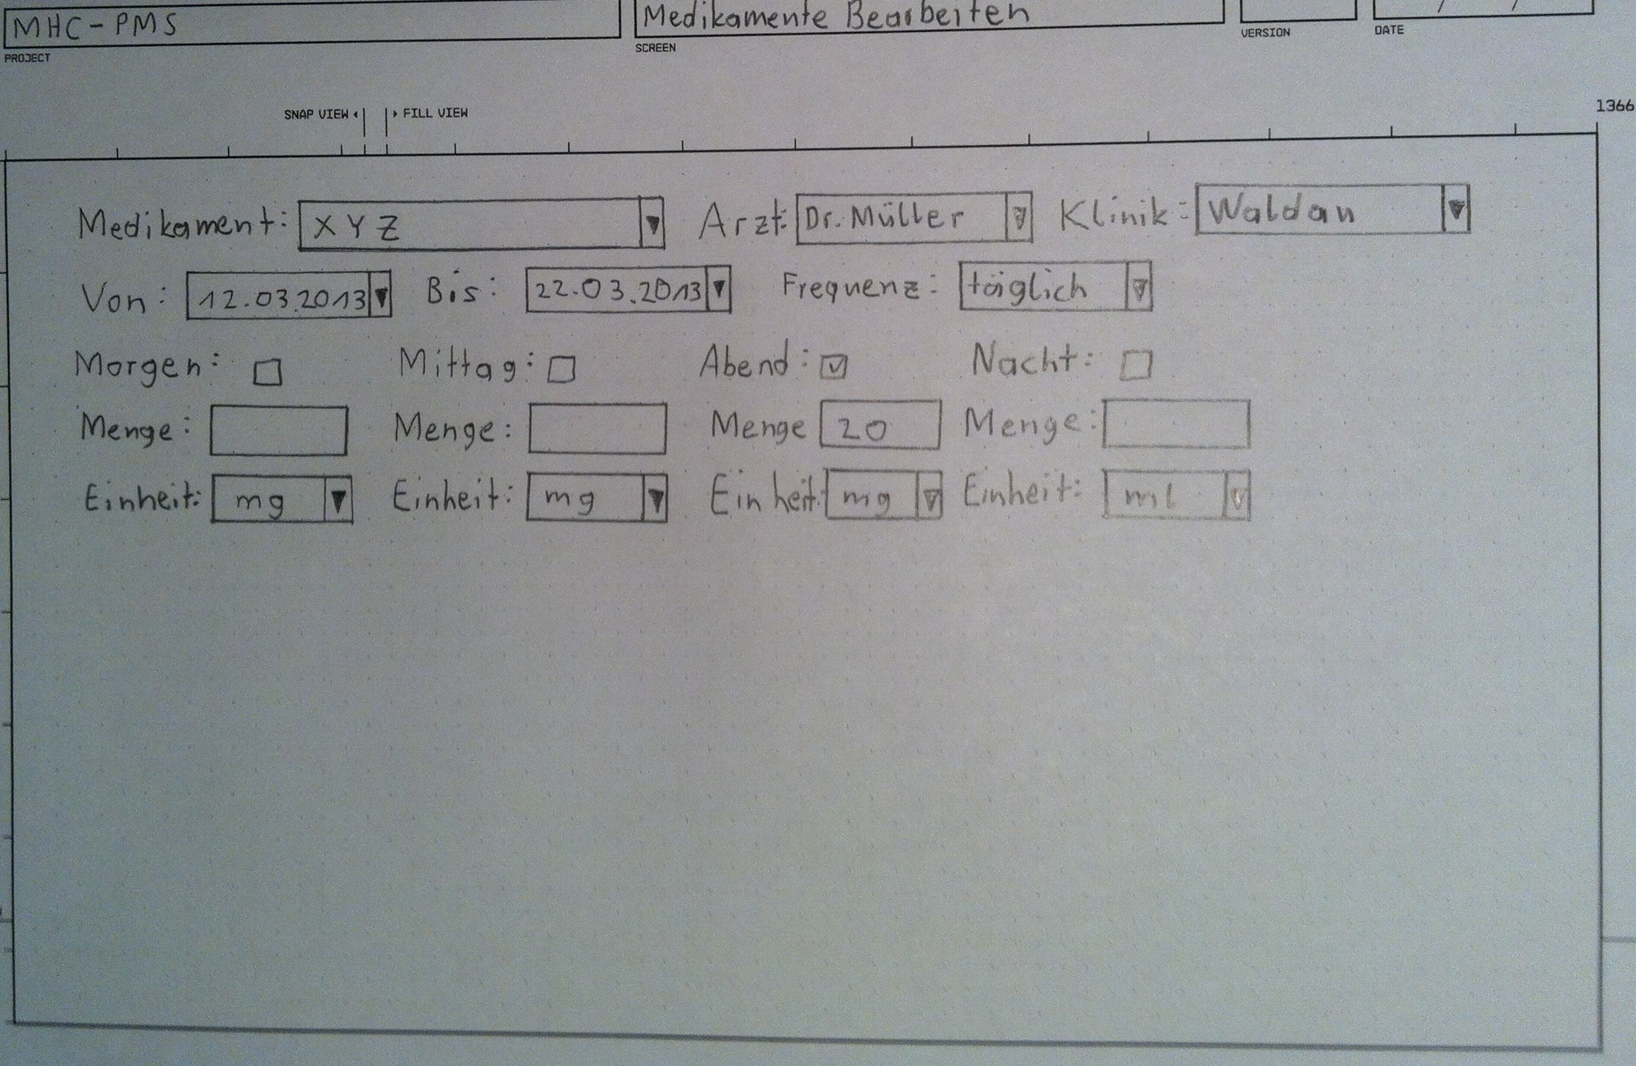

Slide 15
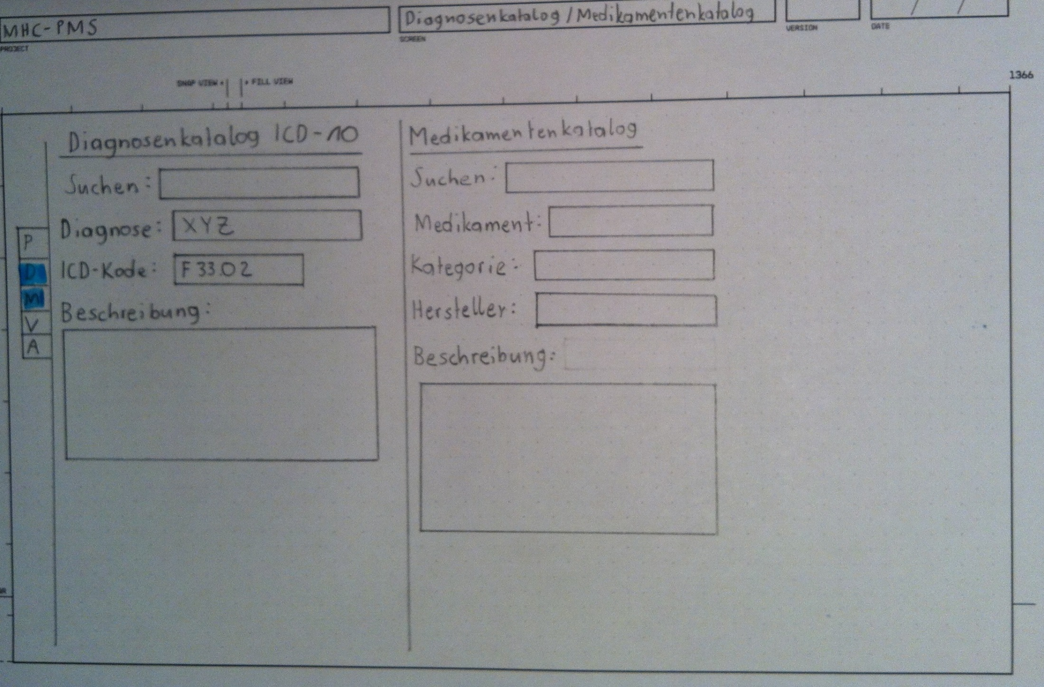

Slide 16
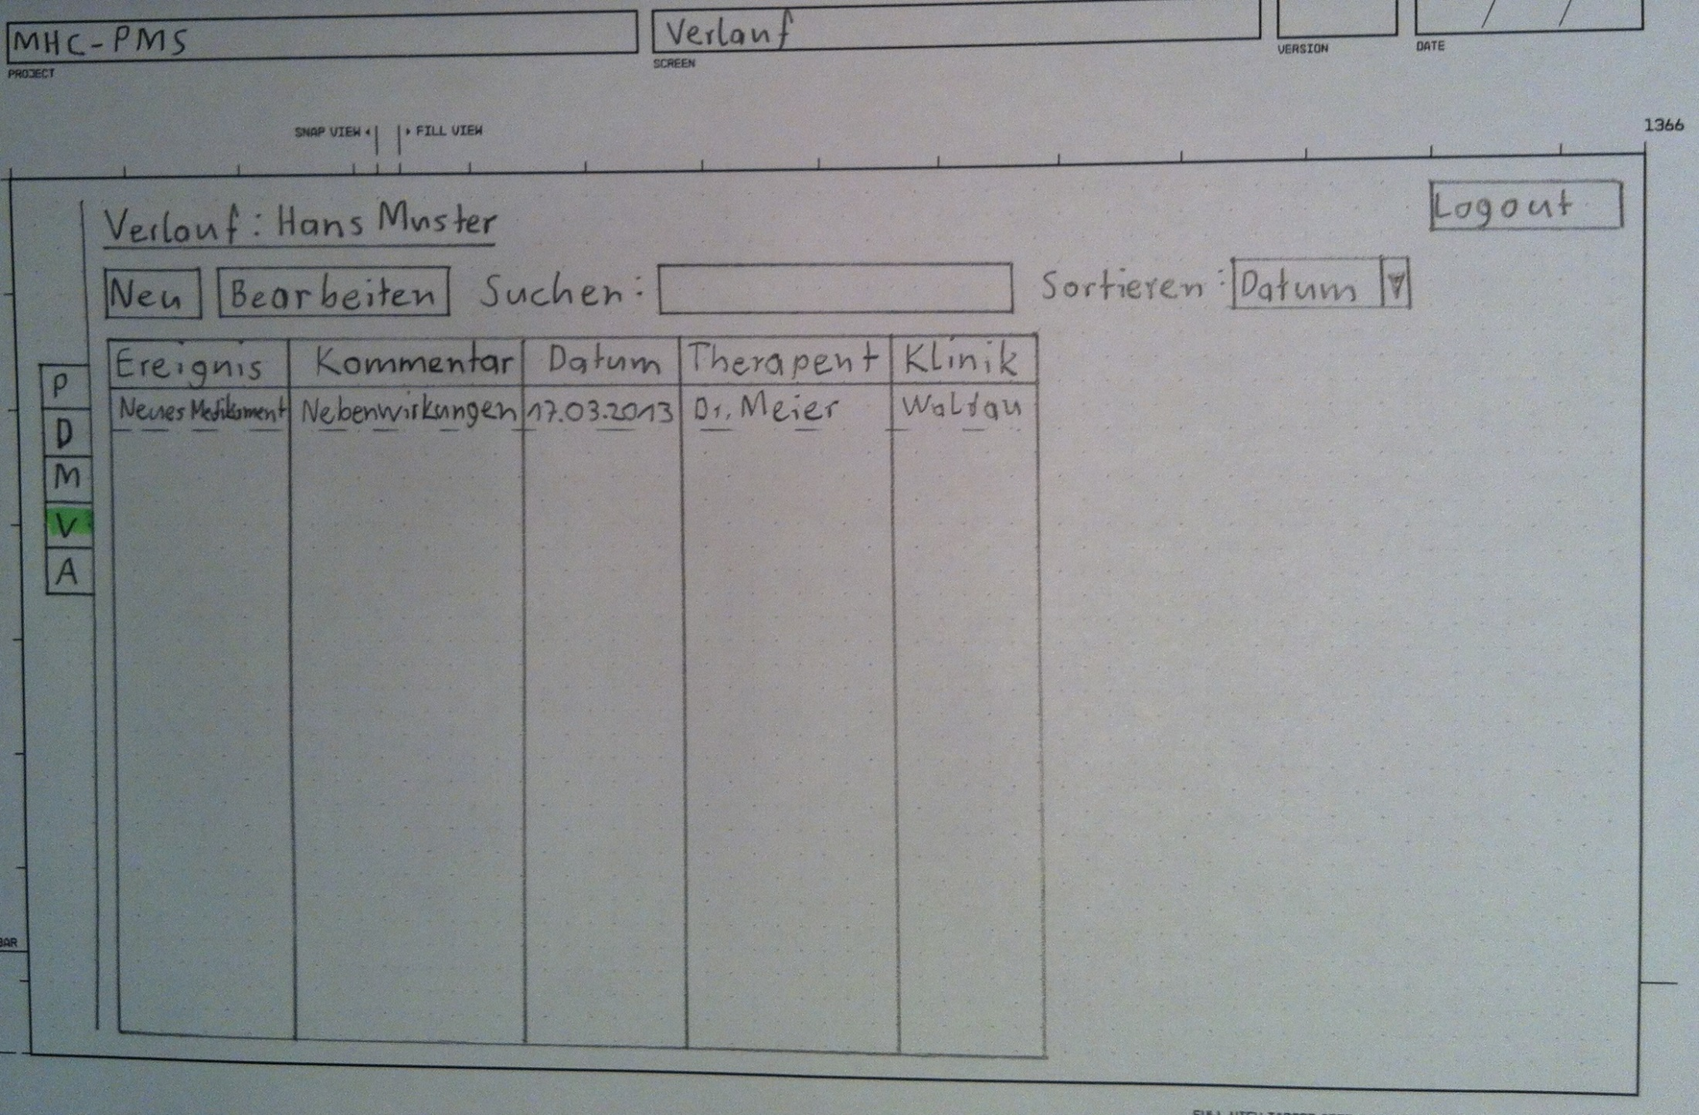

Slide 17
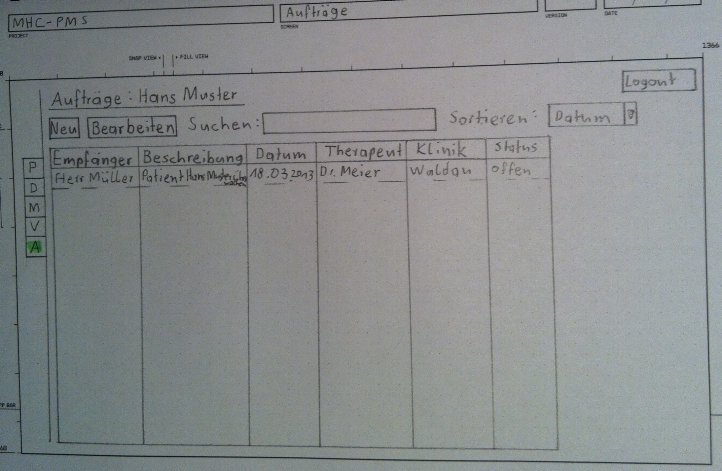

Slide 18
Validate
Full validation by users is not possible at the moment because of the short time horizon.

